Slide 1

Predicting the NBA Playoffs
CMSE 202 Section 004
Jagar, Max, Stephane, Tyler

Slide 2

Our Goal:
Create a model to accurately predict NBA playoff matchups
Which stats are the most telling of which team is better?
How can we use data to create a function?
How can we test our model?

Slide 3

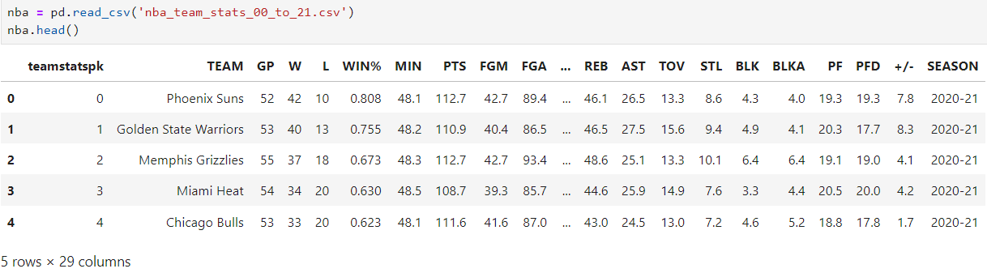
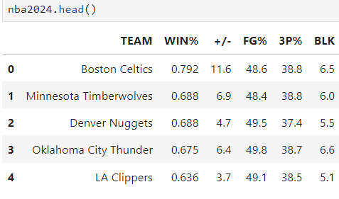
Data Set
https://www.kaggle.com/datasets/mharvnek/nba-team-stats-00-to-18
Data found from Basketball Reference.com and NBA.com
Notes:
Created nba2024 based on only what data we needed.

Slide 4
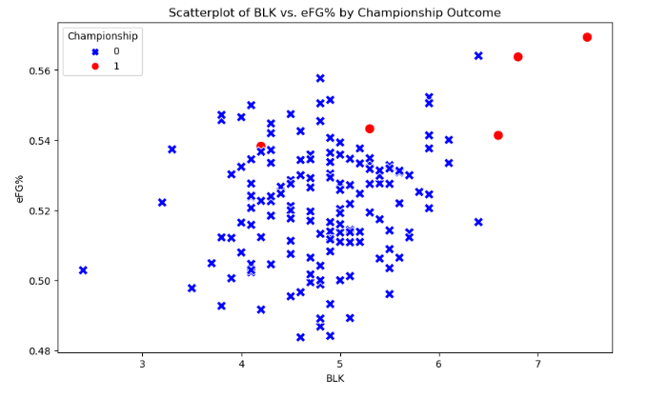
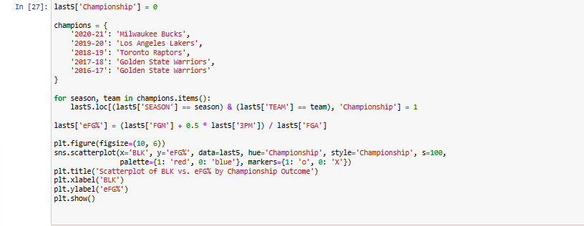
Examining Statistics
Using a scatterplot we tested multiple variables to see which led to a championship in recent years
Found effective field goal percentage which is an overall measure of shooting efficiency
Examining this plotted against blocks per game for a team revealed the championship teams of the last 5 years excel in these areas
Shows championship teams have shooting talent and good rim protection
Notes:
Plotted the adjusted R-squared values, NOTE: can’t draw conclusions from W, L, or WIN% because these directly affect win percentage.

Slide 5
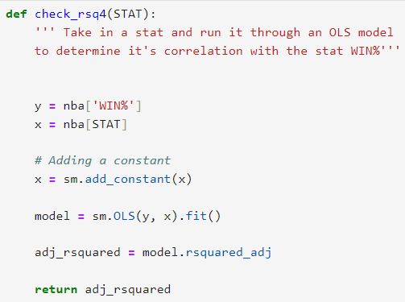
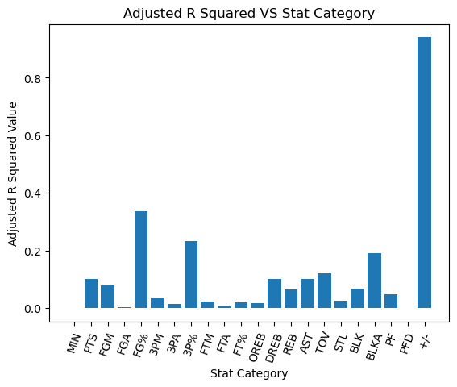
OLS Model
Used linear regression from statsmodels OLS.
Predicting WIN%, and what variables correlate with it most.
+/-, FG%, and 3P%.
Notes:
Plotted the adjusted R-squared values, NOTE: can’t draw conclusions from W, L, or WIN% because these directly affect win percentage.

Slide 6
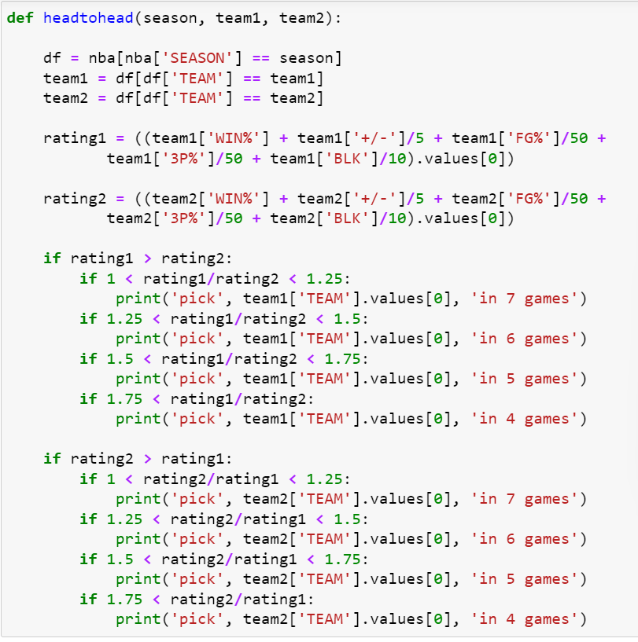
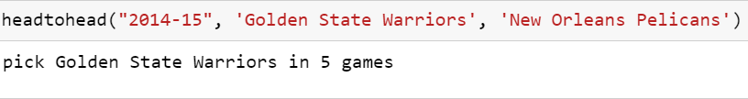
The Function
Makes a df for the season and for both teams
Adds up different stat categories with different weights to compute a rating for each team
Decides which team will win based on whose rating is higher
Decides how many games it will take (7 game series) based on how much higher the winning team’s rating is.

Slide 7
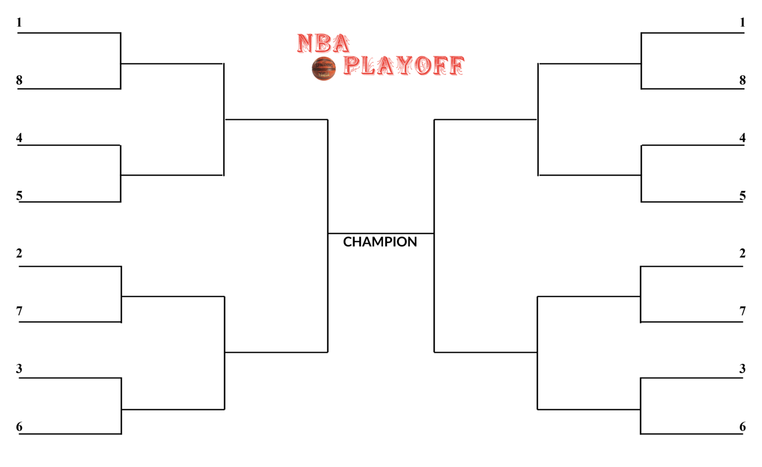


2015
GSW
ATL
GSW
ATL
NOP
BRK
GSW
ATL
POR
TOR
POR
TOR
MEM
WAS
GSW
GSW
ATL
HOU
CLE
HOU
CLE
DAL
BOS
LAC
CLE
LAC
CHI
LAC
CHI
SAS
MIL
Correctly Predicted 11/15 games

Slide 8
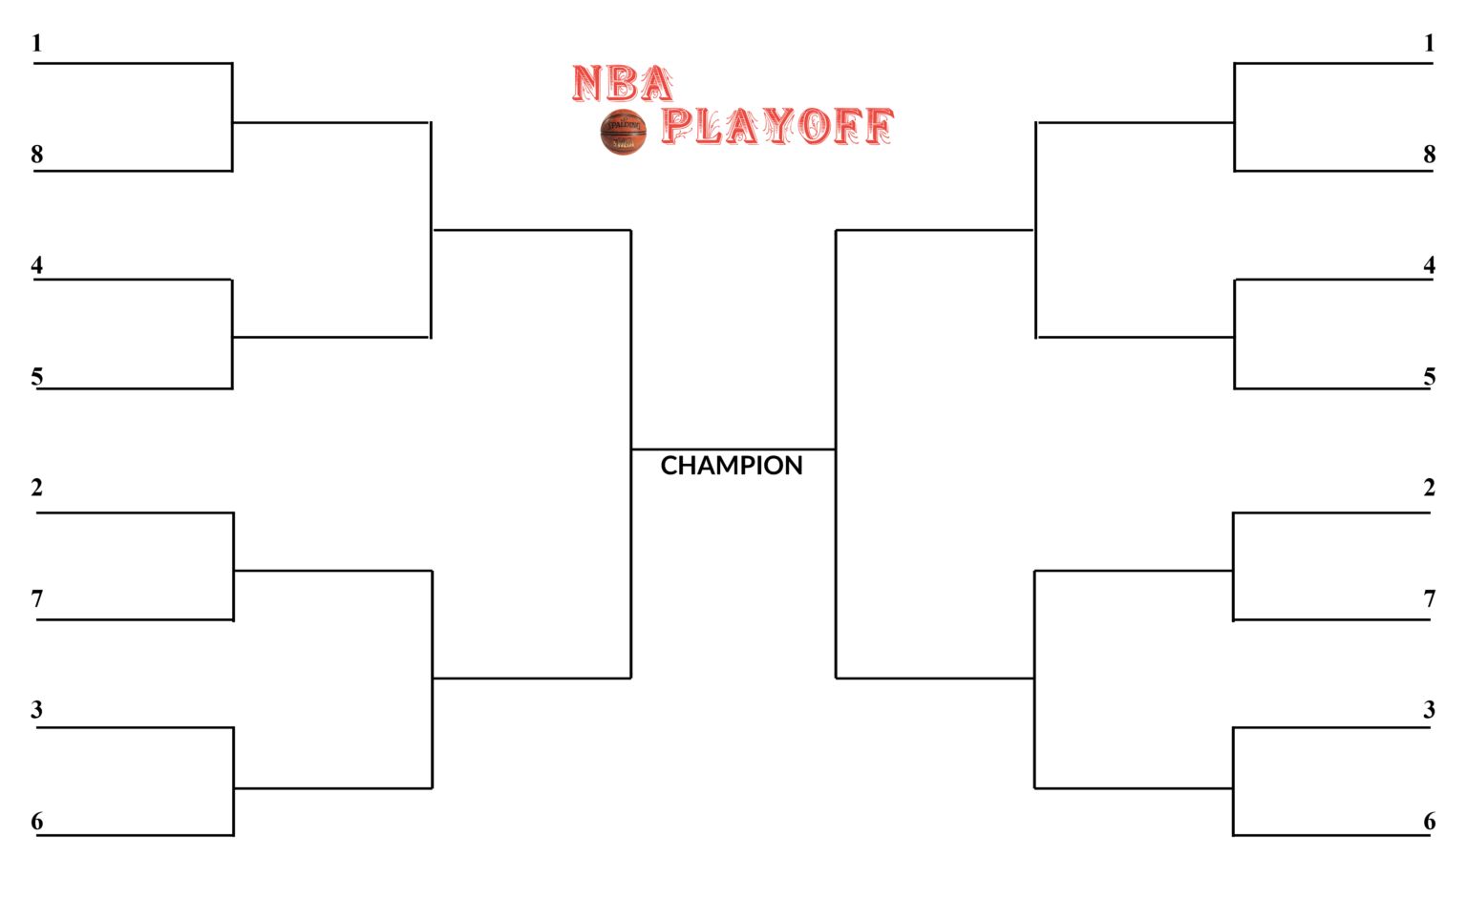

DEN
(in 5)
Predicted 2024
BOS
(in 4)
DEN
(in 6)
BOS
(in 4)
GSW
MIA
BOS
(in 4)
LAC
(in 6)
DEN
ORL
LAC
NYK
NYK
(in 6)
DAL
BOS
(in 5)
MIN
(in 5)
MIN
BOS
MIL
(in 6)
MIN
(in 7)
MIL
(in 7)
NOP
PHI
MIN
(in 5)
OKC
(in 5)
MIL
CLE
IND
OKC
IND
(in 7)
PHX
*Standings and statistics as of 4/7/2024

Slide 9
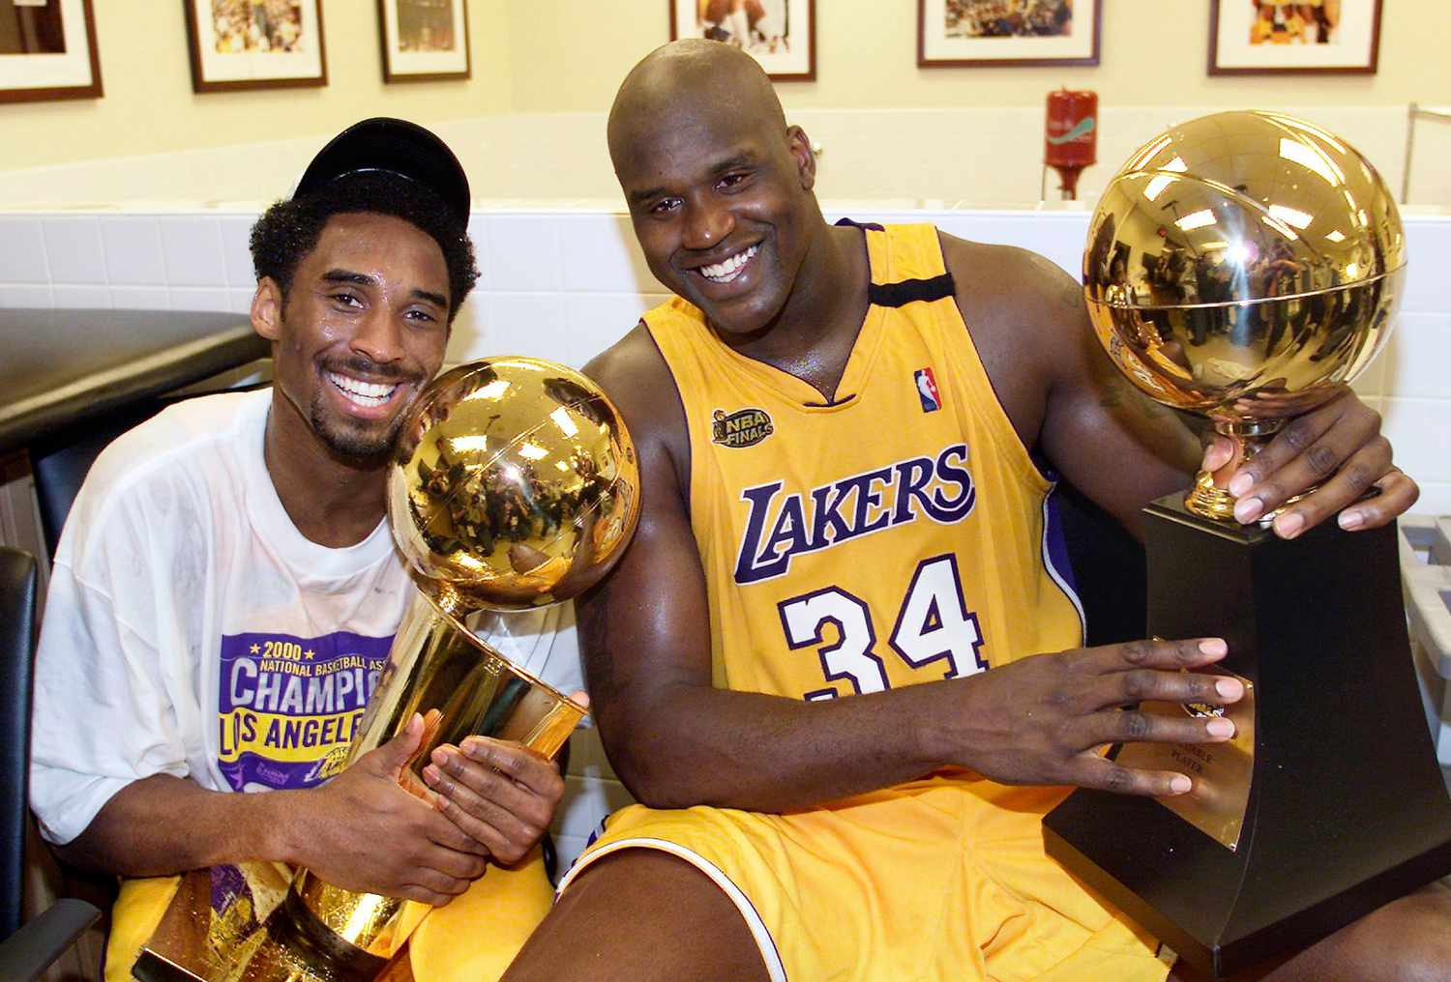

Difficulties or Complications
Choosing which stats to use in the function
How to weigh the rating system
Not having a complete set of data for this season
Working with parameters for determining the length of the series

Slide 10
Questions?

Slide 11
Sources
https://www.kaggle.com/datasets/mharvnek/nba-team-stats-00-to-18
https://www.espn.com/nba/bracket/_/year/2015
Slide theme from:
https://www.slidescarnival.com/cordelia-free-presentation-template/216#
Image sources:
https://nba-playoff.com/wp-content/uploads/2020/03/nba-playoff-bracket-1536x942.png
http://www.clipartbest.com/cliparts/nTB/9dE/nTB9dEnTA.png
http://clipart-library.com/images_k/x-mark-transparent-background/x-mark-transparent-background-3.png
https://www.logodesignlove.com/images/classic/nba-logo.jpg
https://i.pinimg.com/originals/8d/9c/90/8d9c9087cf0fe1e3942ddf2d6239e806.jpg

